Slide 1

MITM Attack Prevention and
Analysis
Information Security Analysis and Audit (CSE 3501)

Slide 2
CONTRIBUTORS
Aayushi Jethani
Pratishtha Gaur
K Arjun Rao
1
2
3
19BCE0101
19BCE0104
19BCE2401

Slide 3
Abstract
Proposed Work
01
04
Introduction
Architecture Diagram
02
05
Literature Survey
Code Snapshots
03
06
A concise description of the problem or issue
This part is the ‘how’ of our project will be executed
Here you could describe the
idea of the project
Diagrammatic description of works
Researched Papers to get domain knowledge
Essential parts or functions of the code

Slide 4
ABSTRACT
SECURITY
These days cyberattack is a serious criminal offense and it is a hotly debated issue moreover.
Cyberattacks violates individuals' privacy and the security of their data, particularly hacking, malware, identity theft, financial fraud, medical fraud, without individuals' consent.
It is important to protect ourselves from such crimes
Use prevention measures like installing antivirus and malware.
To protect ourselves from cybercrime we have to be aware of the crimes that exist
Understand attacks first

Slide 5
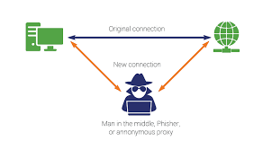
ABSTRACT
A man-in-the-middle-attack is a kind of cyberattack where an unapproved outsider enters into an online correspondence between two users.
MITM attack as a protocol is subjected to an outsider inside the system, which can access, read and change secret information without keeping any trace of manipulation.
Hence, MITM attack is one of the most dangerous and effective attacks that you can carry out in a network. This can be done using various techniques.
This project includes analysis on various MITM techniques like ARP Spoofing, Keylogger Attack and Honeypot implementation to catch the attacker etc.

Slide 6
INTRODUCTION
(MITM) attack is a general term for when a perpetrator positions himself in a conversation between a user and an application
Making it appear as if a normal exchange of information is underway.
The goal of an attack is to steal personal information, such as login credentials, account details and credit card numbers.
The first step intercepts user traffic through the attacker’s network before it reaches its intended destination.
After interception, any two-way SSL traffic needs to be decrypted without alerting the user or application.
Next is to restore

Slide 7
INTRODUCTION
Various Man in the Middle attacks are carried out by attackers which include:
The attacker installs a packet sniffer to analyze network traffic for insecure communications.
When a user logs in to a site, the attacker retrieves their user information and redirects them to a fake site that mimics the real one.
The attacker's fake site gathers data from the user, which the attacker can then use on the real site to access the target's information.
Sidejacking - An attacker sniffs data packets to steal session cookies from your device, allowing them to hijack a user session if they find unencrypted login information.
Evil Twin - An attacker duplicates a legitimate Wi-Fi network, enabling them to intercept data from users who believe they are signing on to the real network.

Slide 8
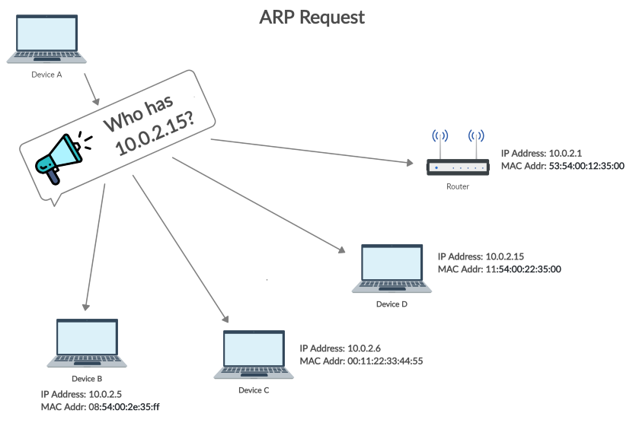
ARP
ARP is used to find out the MAC Address of a particular device whose IP address is known.
The sending device sends an ARP Request containing the IP Address of the device it wants to communicate with.
Request is broadcasted meaning every device in the network will receive this but only the device with the intended IP address will respond.
As other hosts on the LAN cache the spoofed ARP packets, data that those hosts send to the victim will go to the attacker instead. From here, the attacker can steal data or launch a more sophisticated follow-up attack.

Slide 9
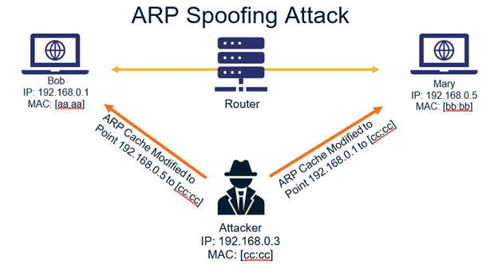
ARP Spoofing
The attacker (hacker) sends forged ARP Messages
Pretend as a legitimate user as it links the attacker machine’s MAC Address to the legitimate IP Address
In ARP Spoofing, the hacker simply fools the access point and the victim by pretending as the access point in front of the victim and as the victim in front of the access point
Victim’s requests now pass through the attacker’s machine instead of the actual access point. This gives a chance to the attacker to intercept, modify, or stop the data transit.

Slide 10
Keylogger
A keylogger is an insidious form of spyware. You enter sensitive data onto your keyboard, believing nobody is watching. In fact, keylogging software is hard at work logging everything that you type.
Keyloggers are activity-monitoring software programs that give hackers access to your personal data. The passwords and credit card numbers you type, the web pages you visit – all by logging your keyboard strokes. The software is installed on your computer, and records everything you type. Then it sends this log file to a server, where cybercriminals wait to make use of all this sensitive information.

Slide 11
Honey Pot
A security mechanism that creates a virtual trap to lure attackers.
An intentionally compromised computer system allows attackers to exploit vulnerabilities so you can study them to improve your security policies.
You can apply a honeypot to any computing resource from software and networks to file servers and routers.

Slide 12
Literature Survey
Sr | Title | Description | Inference
1 | Man in the middle attack in wireless and computer networking- a review (IEEE 2017) | MITM attacks have been classified based on various parameters such as attacker location, impersonation techniques and nature of channel and the existing countermeasures are surveyed. The paper categorizes MITM attacks into four categories namely spoofing based MITM, TLS/SSL MITM, BGP MITM and false base station based MITM attack. Various MITM defence mechanisms such as Entropy increasing mechanisms, cryptographic solutions have also been presented. | The attackers target the actual data flowing between the endpoints and compromise the integrity and confidentiality of the data.

Slide 13
Literature Survey
Sr | Title | Description | Inference
2 | The SSL MITM Attacks with DNS Spoofing (Trans Tech Publications, Switzerland 2013) | SSL provides a transparent encryption transmission channel between user browser and website server but has become the most effective way to implement SSL attack, as a result of security leaks caused by certificate validation of browser, user negligence and the website server architecture. In this paper, SSL MITM attack combined with DNS spoofing has been performed to analyse the security about user account login. | The results show that attention needs to be paid to the improvement of network security. It emphasizes that network service providers should take measures to improve data security, such as safe hash calculation about user account and password information referring to data on web pages and data submitted by the user. It highlights that safe DNS service needs to be used to prevent ID spoofing or the injection attack.

Slide 14
Literature Survey
Sr | Title | Description | Inference
3 | A study of Cookies and threats to Cookies (International Journal of Advanced Research in Computer Science and Software Engineering 2016) | One of the main threats to the network is session hijacking which can be carried out with the help of cookie exploitation. There are many websites which are vulnerable to cookie theft. In this paper, various methods to steal the cookies which are used by the attacker have been discussed. It also explains the working of cookies to give a clear idea about Session hijacking which deals with cookies. | Remedy for Sniffing Network Traffic for Cookies: Using a long number or string instead of a small number or string as the session key. So, an attacker is not able to brute force the session-id. Remedy for Cross-Site Scripting Attack: Filtering i.e. passing external data through a filter which would remove the dangerous keywords. Also, escaping dangerous character with the help of escaping characters can serve as a solution. Remedy for Cross-site request forgery (CSRF) Attack: Using a Synchronizer token pattern.

Slide 15
Literature Survey
Sr | Title | Description | Inference
4 | Man in the middle attacks detection tool design (International Journal of Engineering Sciences and Research Technology 2018) | In this study their aim was to create a MITM detection tool which detects ARP spoofing attacks on LANs. This attack can induce a high level of threats on the targets and so it is crucial to be protected against this type of attack. This study suggests a better perspective to the users, software developers and security administrators about the key features of the MITM detection tool that can be used as a solution. Some of the ARP spoofing detection methods that are mentioned in this journal are: Using static ARP tables Secure ARP(S-ARP) Ticket based ARP(TARP) | One of the advantages of the tool that is designed in this journal is that the tool does not require high fees for third party software and provides the users with flexibility in taking measures against MITM attacks using ARP spoofing technique. Just like honeypot The tool which the authors developed detected MITM attacks rather quickly and efficiently.

Slide 16
Literature Survey
Sr | Title | Description | Inference
5 | Mitigating ARP poisoning-based man-in-the-middle attack in wired or wireless LAN (EURASIP journal on wireless communications and networking 2012) | In this paper, an enhanced version of address resolution protocol (ARP) is proposed to prevent ARP poisoning-based man-in-the-middle (MITM) attacks in wired or wireless LAN environments. The proposed scheme is based on two key concepts: long term IP/MAC mapping table and computational puzzle-based voting. The ARP poisoning attack refers to the behaviour of registering a false (IP, MAC) address mapping in the ARP cache of another node for malicious purposes. The proposed mechanism is based on the idea that when a node knows the correct MAC address for a given IP address, if it does not delete the mapping while the machine is alive | In this paper, an enhanced version of address resolution protocol (ARP) is proposed to prevent ARP poisoning-based man-in-the-middle (MITM) attacks in wired or wireless LAN environments. The proposed scheme is based on two key concepts: long term IP/MAC mapping table and computational puzzle-based voting. The ARP poisoning attack refers to the behaviour of registering a false (IP, MAC) address mapping in the ARP cache of another node for malicious purposes. The proposed mechanism is based on the idea that when a node knows the correct MAC address for a given IP address, if it does not delete the mapping while the machine is alive

Slide 17
Proposed System
Man in the middle attack: These are attacks that we can launch only if we are able to intercept the communication between two devices.
A normal communication would look like this where the device is directly communicating with the entity that they want to communicate with in man in the middle attack.
Using an ARP spoofing attack ARP spoofing allows us to redirect the flow of packets. So instead of it flowing as shown in this diagram it would flow through our own computer.
This means that any messages, any websites and images and usernames and passwords entered by the target will have to flow through our computer. This allows us to read this information, modify it or drop it.

Slide 18
Proposed System
We did a thorough analysis of the various real time MITM attacks. We successfully implemented MITM attacks using various tools.
We also implemented ARP spoofing attacks using our python code. Further we were able to detect MITM attacks carried out on target machines.
Moreover, we implemented Honeypot to prevent various websites from MITM attacks.
In keylogger implementation we focussed on taking real time screenshots of the system and also storing the details of the keys pressed by the user in a text file.

Slide 19
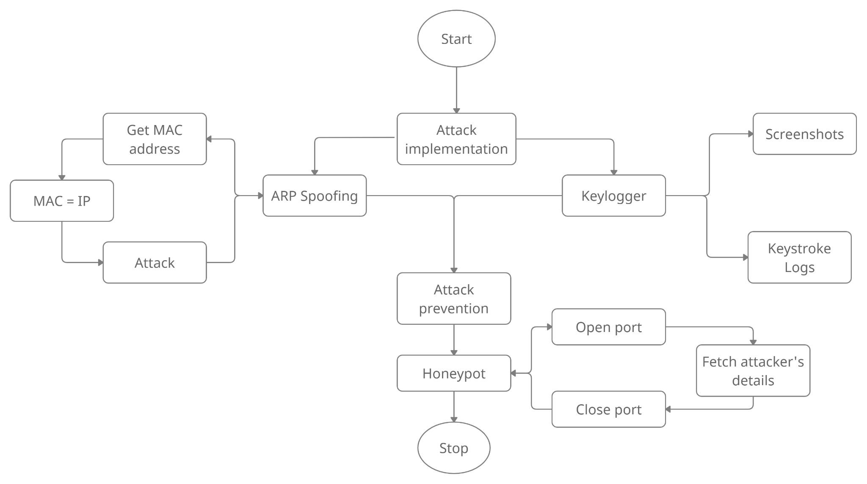
Architecture Diagram

Slide 20
Demo design
Input
Output
IP Address
Gateway Address
Both attacker and victim have to be on the same network
User Data in different forms.
Text document of everything user writes after attack
Screenshot of everything user does.

Slide 21
Algorithm
Arp spoofing
The attacker opens an ARP spoofing tool and sets the tool’s IP address to match the IP subnet of a target.
The attacker uses the ARP spoofing tool to scan for the IP and MAC addresses of hosts in the target’s subnet.
The attacker chooses its target and begins sending ARP packets across the LAN that contain the attacker’s MAC address and the target’s IP address.
As other hosts on the LAN cache the spoofed ARP packets, data that those hosts send to the victim will go to the attacker instead. From here, the attacker can steal data or launch a more sophisticated follow-up attack.
After stopping the attack all caches are restored.

Slide 22
Algorithm
Keylogger
Execute keylogger in somebody’s system either manually or through spam mail make them download self executable file
In the code define keylogger log format.
What all keys should write what in the logs.
Frequency with which to take screenshot
Define a location in server to where files must be stored

Slide 23
Algorithm
Honeypot
Define a computer you want to protect and trap the hacker using
Note its ip address
Open a port for attacker to attack
Build socket connection when hacker tries to access port.
Fetch attackers info and close port and connection.

Slide 24

Code Snapshots

Slide 25
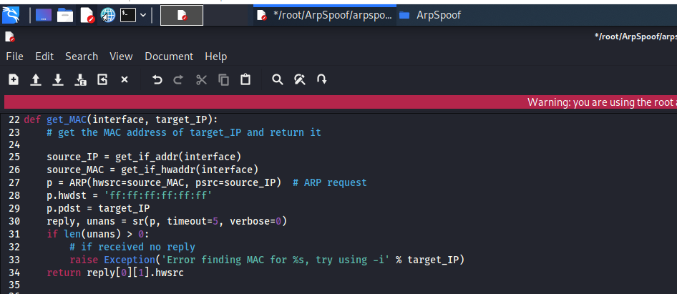

Slide 26
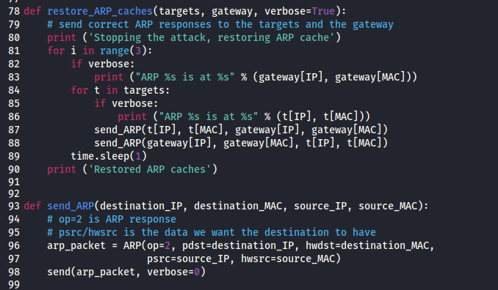

Slide 27
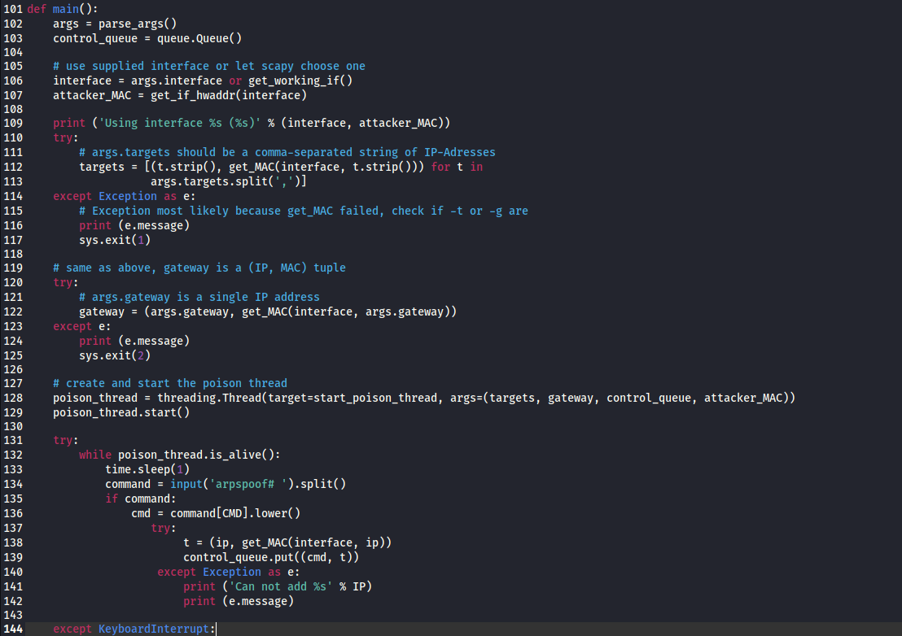

Slide 28
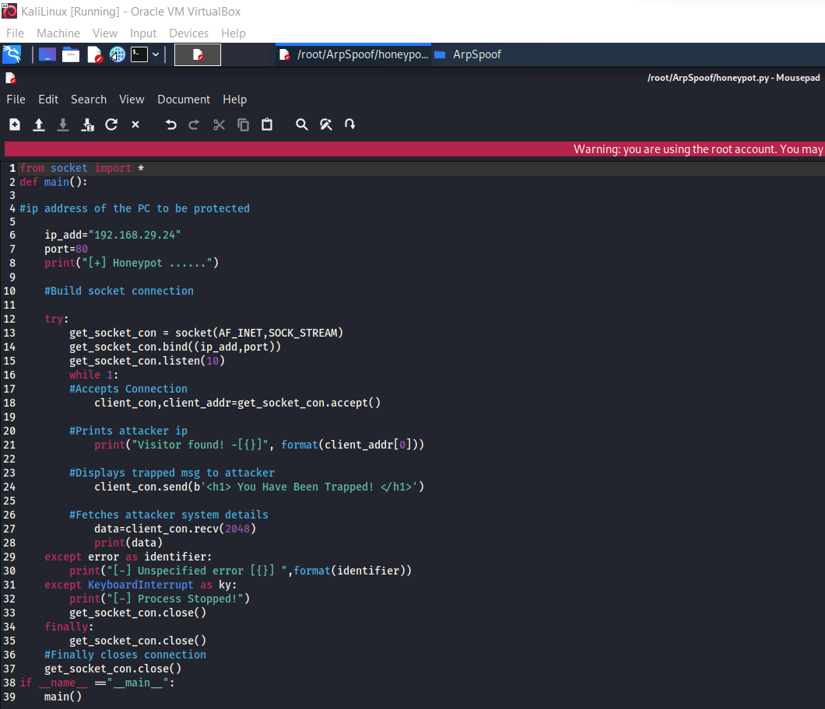

Slide 29
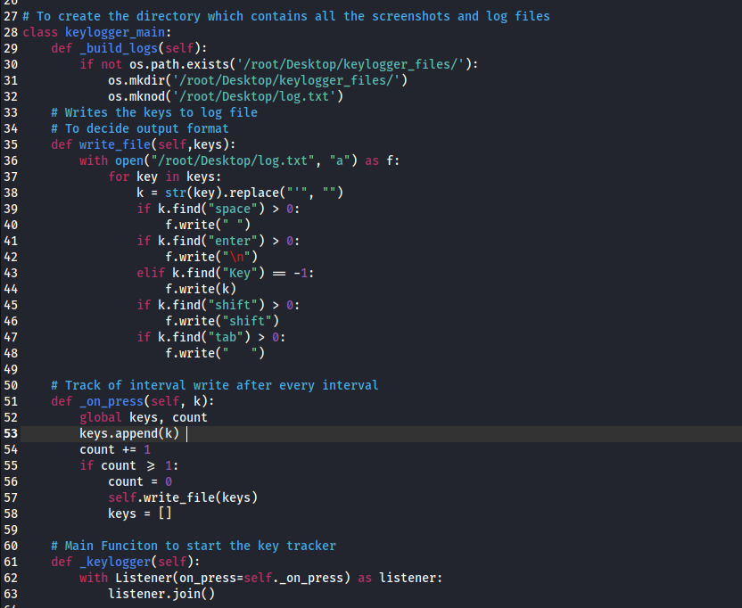

Slide 30
Result
Discussion

Slide 31
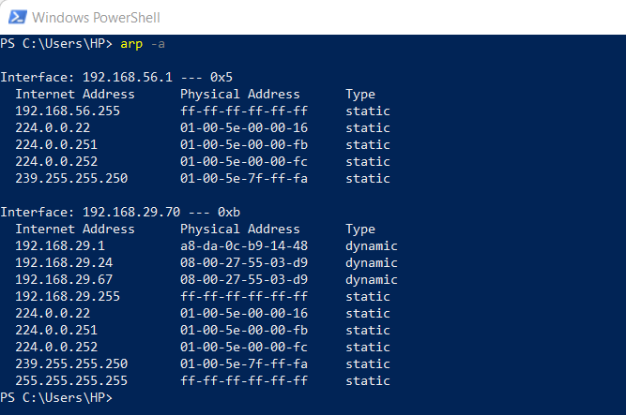
Notes:
Windows PC arp table before attack:

Slide 32
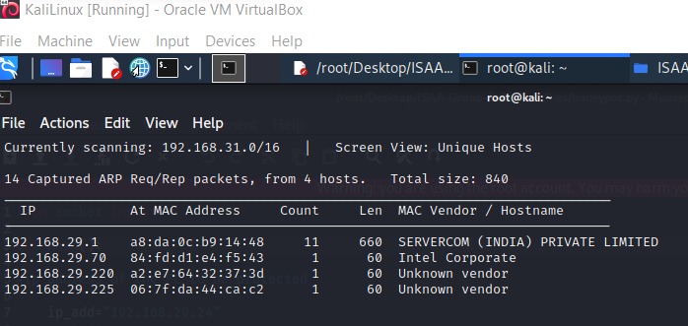
Notes:
Windows PC IP address fetch using netdiscover command

Slide 33
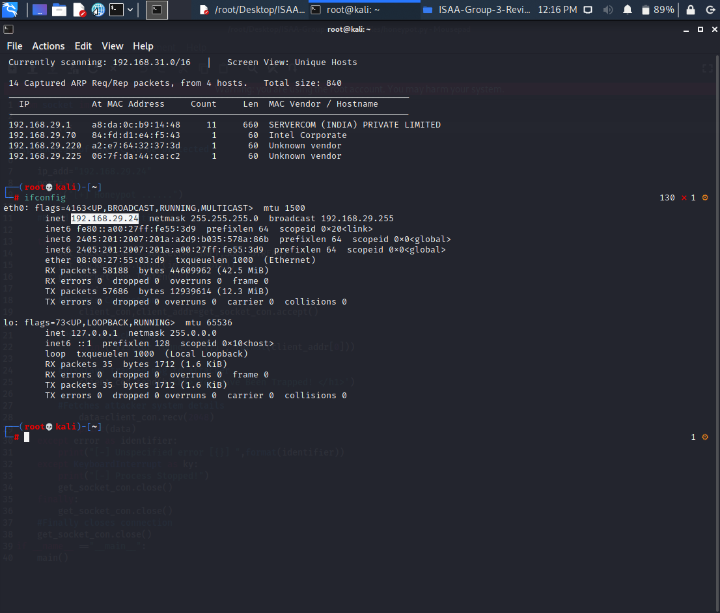
Notes:
Kali IP address:

Slide 34
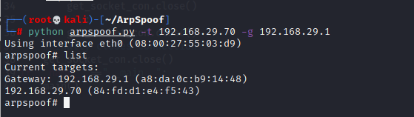
Notes:
Run Python Code with host ip and gateway addresses:

Slide 35
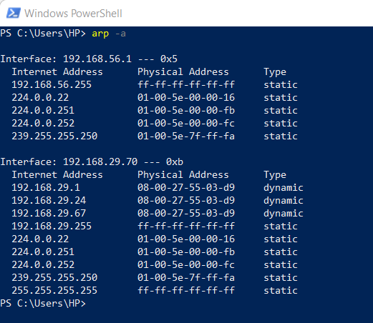
Notes:
Windows PC arp table after attack:

Slide 36
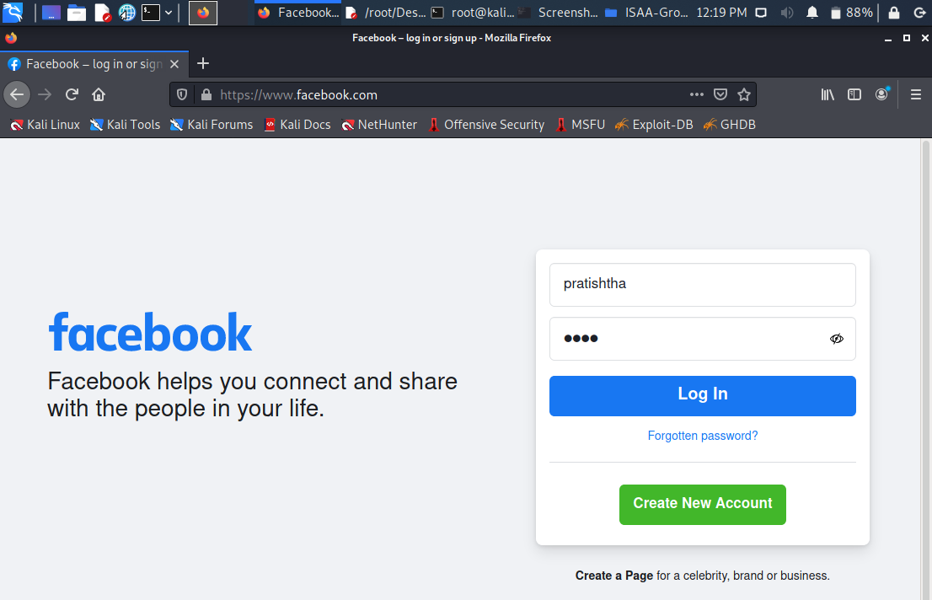
Notes:
Run Python Code:
Surf different websites

Slide 37
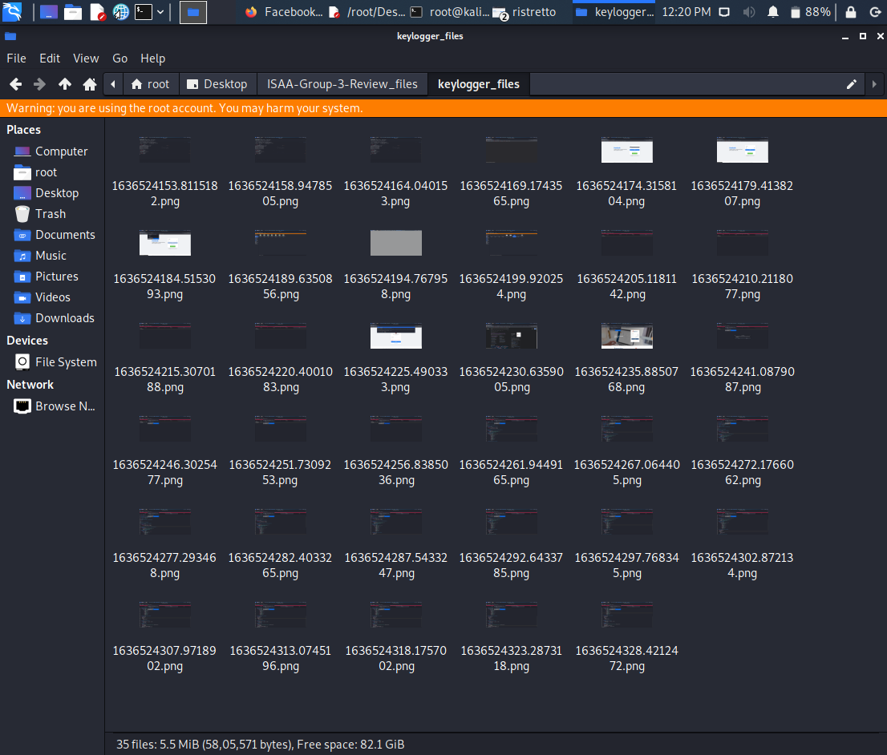
Notes:
Keylogger screenshot saved as timestamp

Slide 38

Notes:
Log.txt saved all keypress in the format specified in code

Slide 39


Slide 40
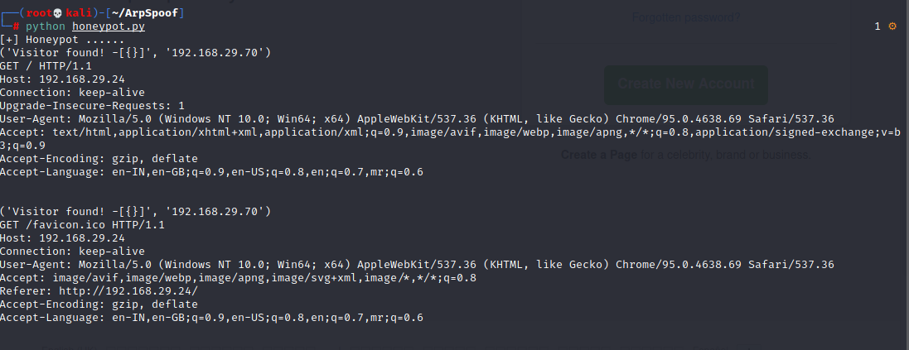

Slide 41

Dependencies
Make a virtual machine for Kali linux
Connect it as bridged network to connect through wifi
Laptop connected with a wifi
All mss, listener for keylogger to take screenshot
All socket libraries for honeypot
Code work in root mode

Slide 42
References
Bharat Bhushan, G Sahoo, Amit Kumar Rai (2017). Man-In-The-Middle Attack in Wireless and Computer Networking: A review. IEEE
Zhang Yalan, Xia Guishu (2013). The SSL MITM Attack with DNS Spoofing. Trans Tech Publications, Switzerland
Rajinder Singh, Dr. Satish Kumar (2016). A Study of Cookies and Threats to Cookies. IJARCSSE
Baris Celiktas et al (2018). Man in the Middle attack detection tool design. International Journal of Engineering Sciences and Research Technology

Slide 43
References
Seung Yeob Nam et al (2018). Mitigating ARP poisoning-based man-in-the-middle attack in wired or wireless LAN. EURASIP Journal on wireless communications and networking
Huan Ma et al (2016). Bayes-Based ARP Attack Detection Algorithm For Cloud Centres. Tsinghua Science and Technology ISSN
SURVEY ON KEYSTROKE LOGGING ATTACKS Kavya .C 1 , Suganya.R 2
Maderi Lavanya et al (2016). IP spoofing and its Detection Technique. International Journal of Advance Computing technique and Applications

Slide 44


